Slide 1


PERCEPTION FOR A SELF DRIVING CAR MULTI OBJECT TRACKING AND TRAJECTORY PREDICTION
Vinit Awale

Slide 2
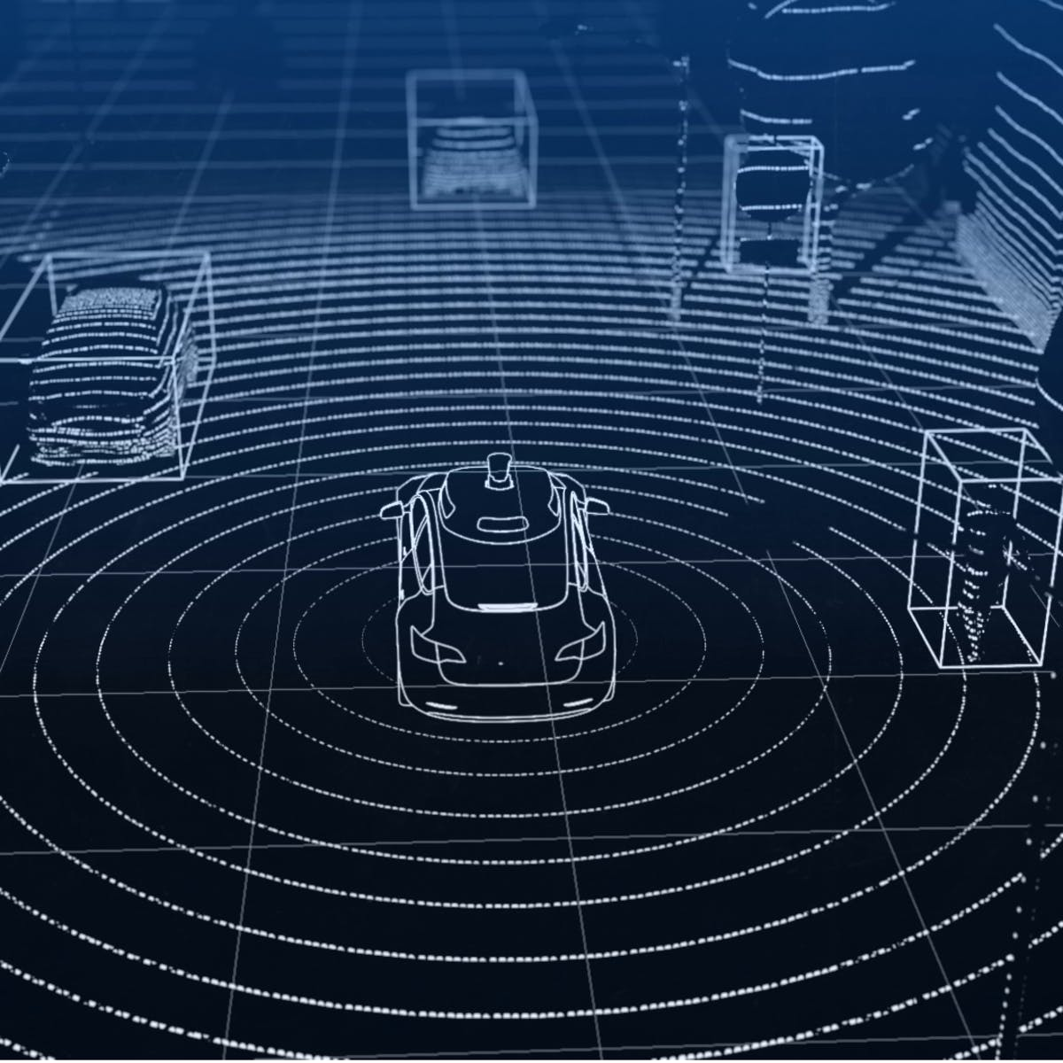
INTRODUCTION
PERCEPTION: THE EYES OF A SELF DRIVING CAR
Perception is a central problem for any autonomous agent, be it humans, robots or self-driving vehicles.
Perception is crucial for the safe and reliable operation of any autonomous agent.
Better perception helps for a smoother and more reliable control of the car using the path-planning module of the autonomous agent. It can also aid in localization.
Typically for a Self Driving Vehicle (SDV), sensors such as RADAR, LiDAR, cameras are used for the task.
For this project we are working with camera as our primary sensor.
Source: https://www.coursera.org/learn/visual-perception-self-driving-cars

Slide 3
PERCEPTION TASKS IMPLEMENTED
OBJECT DETECTION
MULTI OBJECT TRACKING
TRAJECTORY PREDICTION

Slide 4
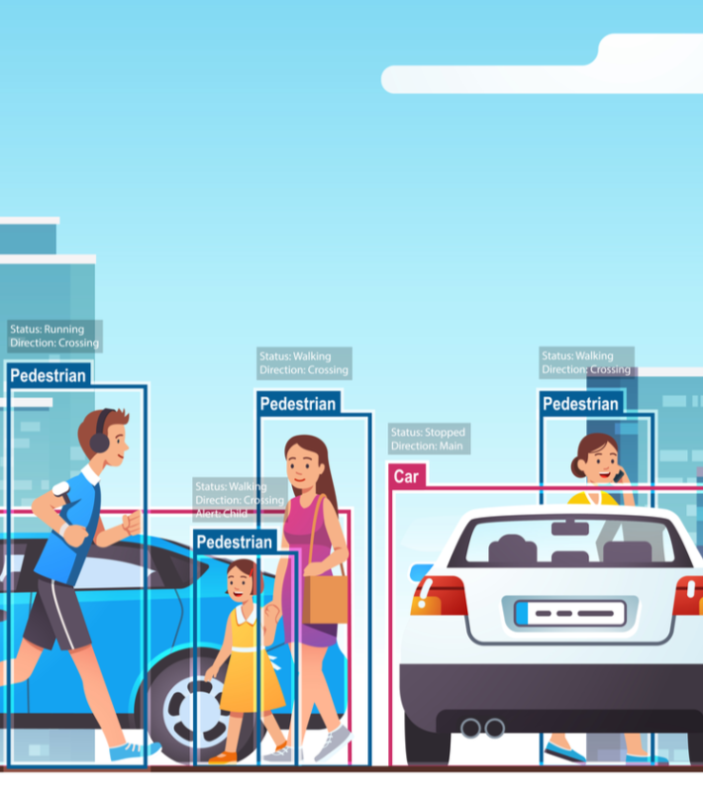
OBJECT DETECTION
Let’s Dive In

Slide 5
OBJECT DETECTION
PROBLEM STATEMENT What objects are present in a given image and where are they?
MODELING THE PROBLEM
Input Image
Output
Solving the where problem Bounding box surrounding the objects
Solving the what problem: Class label for each of the detected objects

Slide 6
BACKGROUND AND PREVIOUS APPROACHES
SLIDING WINDOW OBJECT DETECTION
RCNN
FAST RCNN
YOLO
FASTER RCNN

Slide 7
Why yolo?
YOLO is an abbreviation for the term ‘You Only Look Once’.
This is an algorithm that detects and recognizes various objects in a picture (in real-time). Object detection in YOLO is done as a regression problem and provides the class probabilities of the detected images.
YOLO algorithm employs convolutional neural networks (CNN) to detect objects in real-time.
As the name suggests, the algorithm requires only a single forward propagation through a neural network to detect objects.

Slide 8
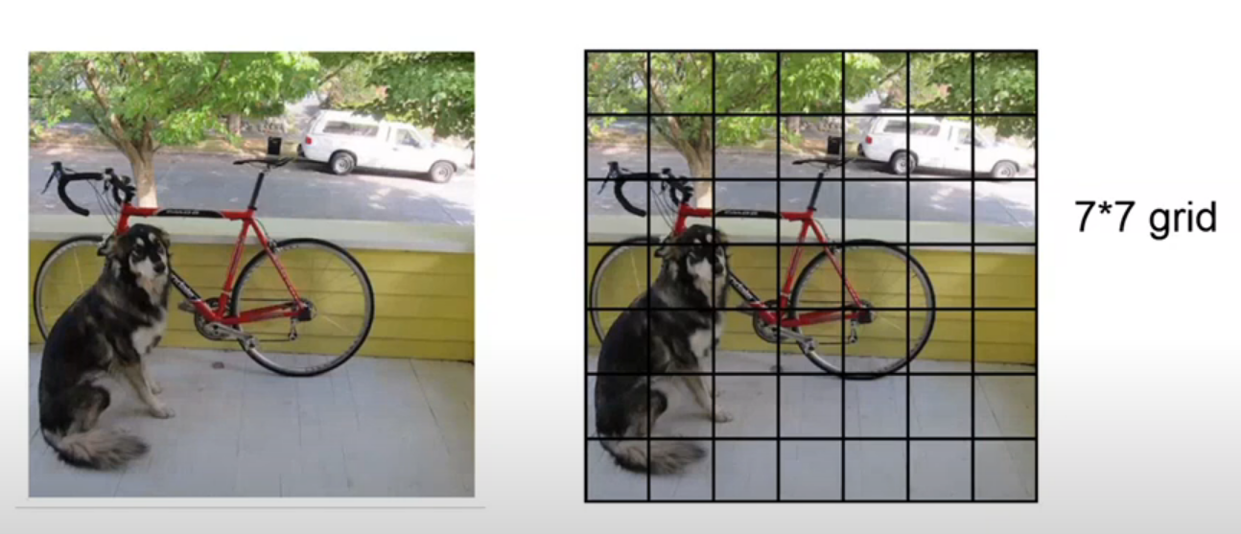
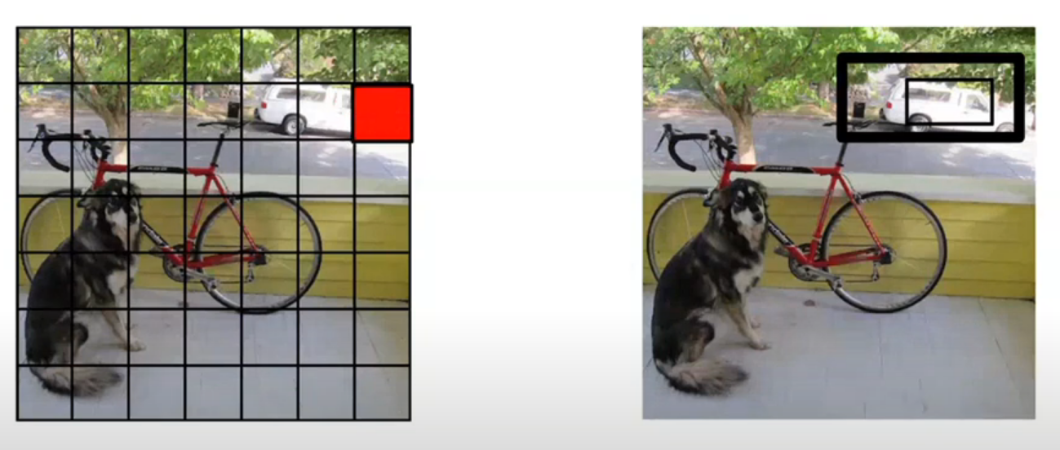
Working of the YOLO algorithm
First split the image into smaller S x S (= 7x7) grid cells.
For each grid cell make predictions of B (=2) bounding boxes (x_{centre} ,y_{centre} ,width, height) and confidence for each bounding box (P[object]).

Slide 9
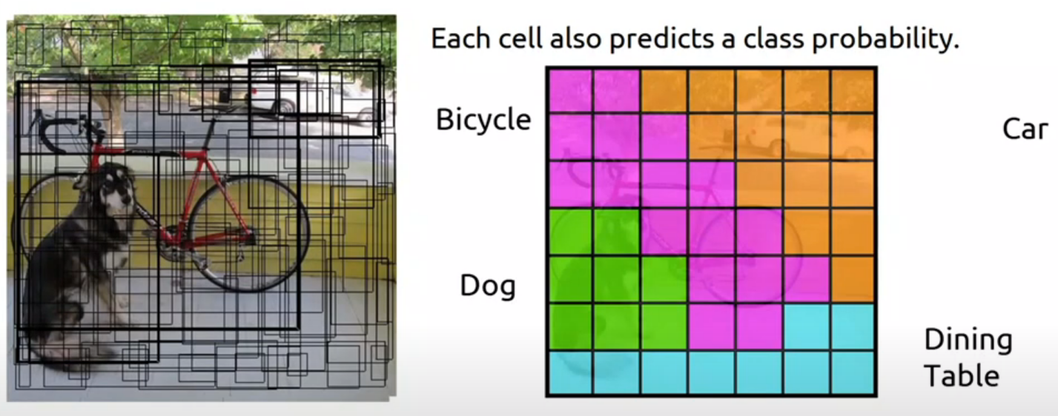
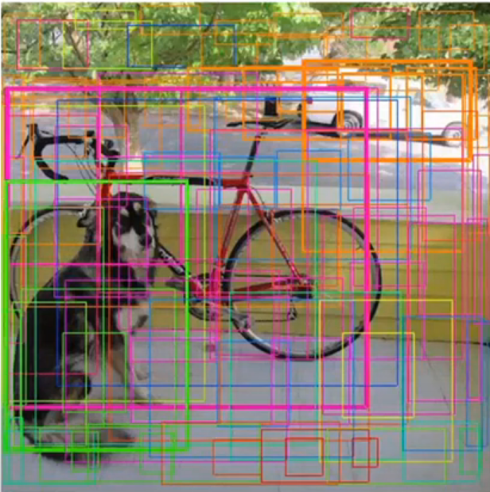
Working of the YOLO algorithm
Along with this the model also predicts conditional class probability (out of the C classes) i.e. P[class_{i}|object] for each grid cell.
Then we combine box and class predictions.
P[class_{i}|object] * P[object] = P[class_{i}]

Slide 10

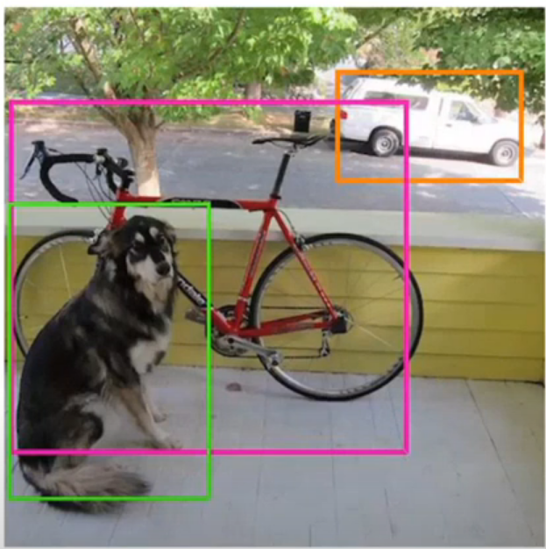
IMPROVING THE ALGORITHM
HOW TO SOLVE THE PROBLEM OF MULTIPLE BOUNDING BOXES?
Use Non-Maximal Suppression
Find the IoU (Intersection over Union) for all the bounding boxes of the same class.
Keep the bounding box with maximum class probability and discard other bounding boxes with IoU > threshold.
Final result after Non-Maximal Suppression

Slide 11
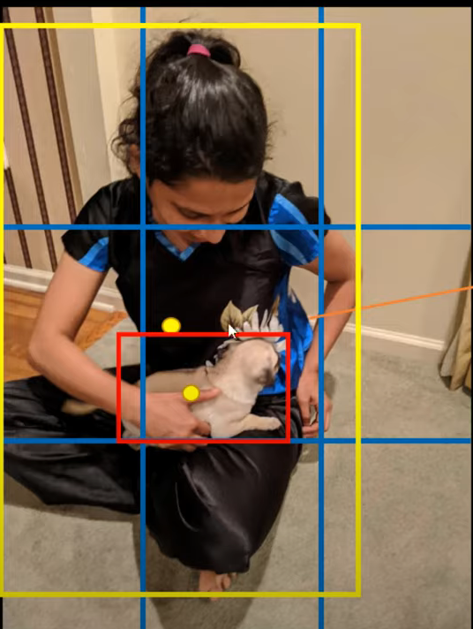
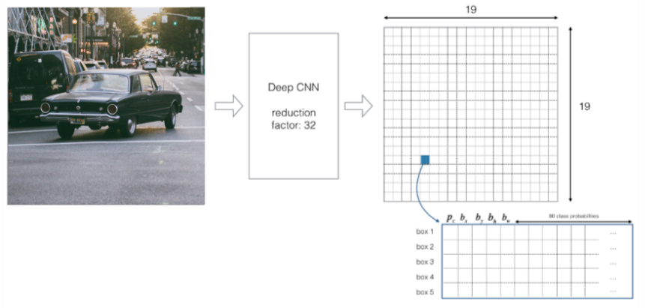
IMPROVING THE ALGORITHM
WHAT IF THE SAME GRID CELL HAS CENTER OF TWO OBJECTS?
Use Multiple Bounding boxes

Slide 12
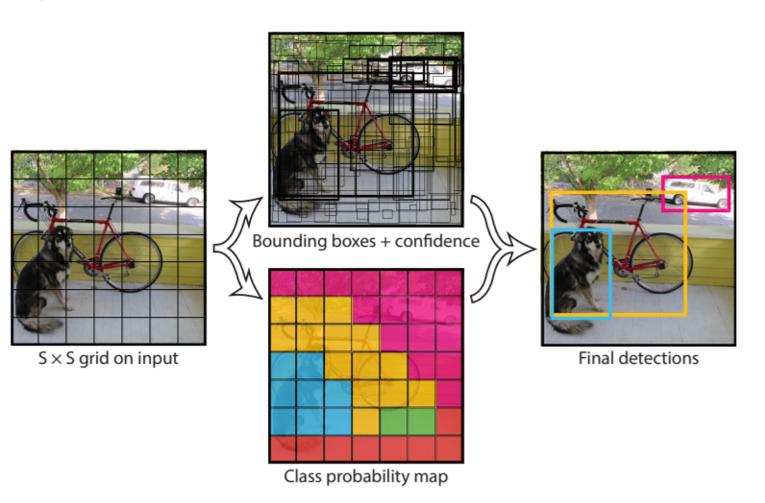
All together
The YOLO algorithm models detection as a regression problem. It divides the image into an S × S grid and for each grid cell predicts B bounding boxes, confidence for those boxes, and C class probabilities. These predictions are encoded as an S x S x (B*(5 + C)) tensor.

Slide 13
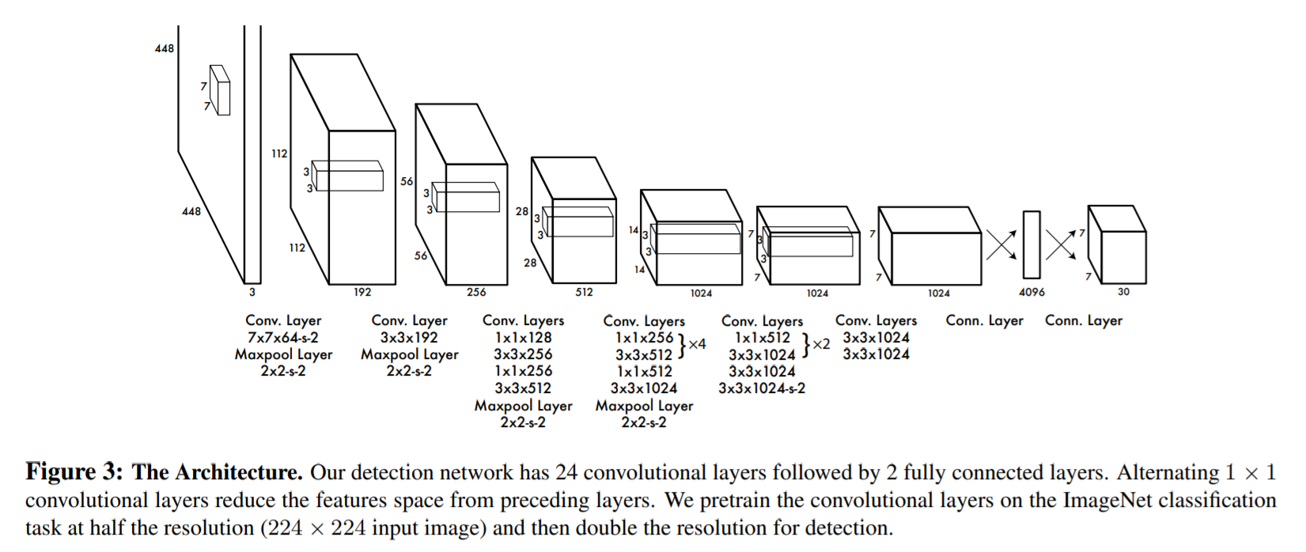
The architecture of yolo
Source: Fig.3 ,You Only Look Once: Unified, Real-Time Object Detection

Slide 14
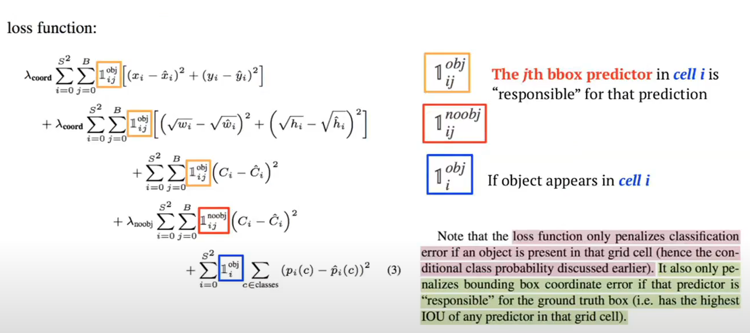
The loss function used for yolo (Sum of squared error)
The loss function can be seen as sum of three types of loss:
Localization Loss
Confidence Loss
Classification Loss

Slide 15
History of yolo
YOLO v1
2016
YOLO v2
YOLO v3
YOLO v4
YOLO v5
2020
2017
2020
2018

Slide 16
Our results
KITTI dataset
Results on KITTI dataset
These are the results obtained on a Nvidia GeForce RTX-3060 mobile GPU

Slide 17
Our results
Lyft Level 5 dataset
Results on Lyft Level 5 Dataset
These are the results obtained on a Nvidia GeForce RTX-3060 mobile GPU

Slide 18
Fps obtained
 | LYFT LEVEL 5 DATASET AVG FPS MIN FPS |  | KITTI DATASET AVG FPS MIN FPS
NVIDIA GEFORCE RTX 3060 | 22.19 | 14.33 | 25.86 | 16.13
NVIDIA TESLA T4 | 30.15 | 21.88 | 31.35 | 19.27

Slide 19
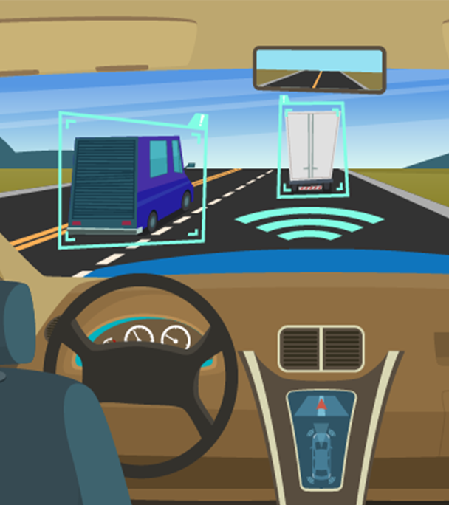
Multi object tracking
Let’s Dive In

Slide 20
Multi-OBJECT Tracking
PROBLEM STATEMENT Given a video (image sequence) which parts of the image depict the same object across different frames
MODELING THE PROBLEM
Input Image sequence (or video) with initial set of object detections
To be done
creating a unique ID for each of the initial detections
tracking each of the objects as they move around frames in a video
maintaining the ID assignment

Slide 21
BACKGROUND AND PREVIOUS APPROACHES
OPTICAL FLOW
MEAN SHIFT
DEEP SORT
KALMAN FILTER

Slide 22
Simple online real time tracking (sort)
SORT is a much simpler framework that is the backbone of the Deep Sort algorithm.
In simpler words, SORT basically comprises of
Detection
Estimation (using Kalman Filter) and track handling
Association (measuring the box overlap and then using Hungarian algorithm for assignment)
Track identity creation and destruction
This simple approach achieves favorable performance at high frame rates.
However, while achieving overall good performance in terms of tracking precision and accuracy, SORT returns a relatively high number of identity switches. This is, because the employed association metric is only accurate when state estimation uncertainty is low.
SORT has a deﬁciency in tracking through occlusions as they typically appear in frontal-view camera scenes.
Hence, we need to improve the association metric.

Slide 23
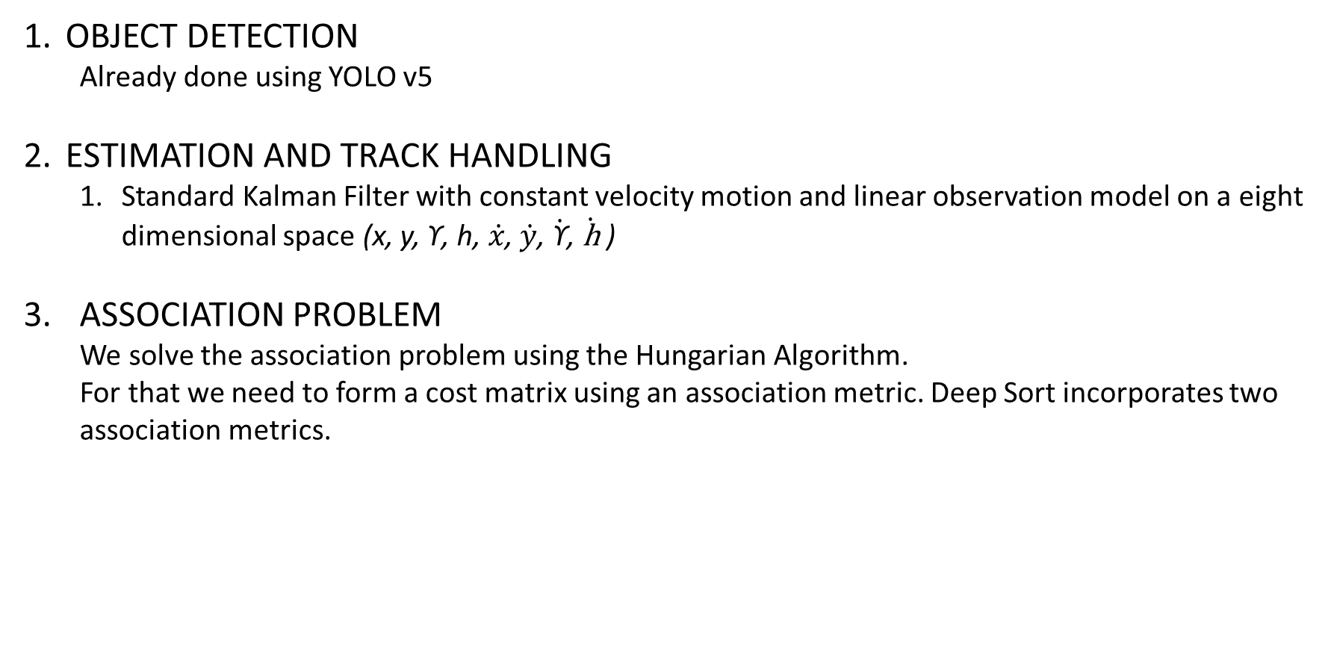
Sort with a deep association metric
OBJECT DETECTION
Already done using YOLO v5
ESTIMATION AND TRACK HANDLING
Standard Kalman Filter with constant velocity motion and linear observation model on a eight dimensional space (x, y, ϒ, h, $\dot{x}$, $\dot{y}$, $\dot{\text{ϒ}}$, $\dot{\text{h}}$ )
ASSOCIATION PROBLEM We solve the association problem using the Hungarian Algorithm. For that we need to form a cost matrix using an association metric. Deep Sort incorporates two association metrics.
Association Metric
Motion Information
Appearance information

Slide 24
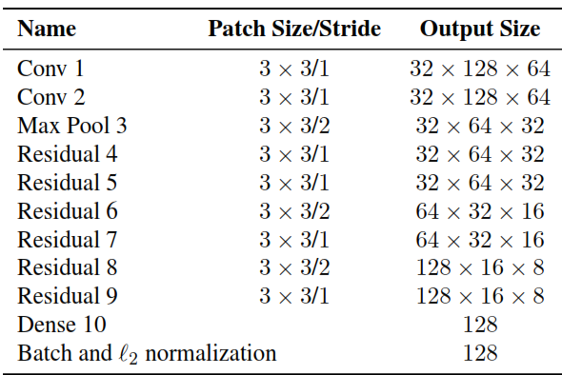
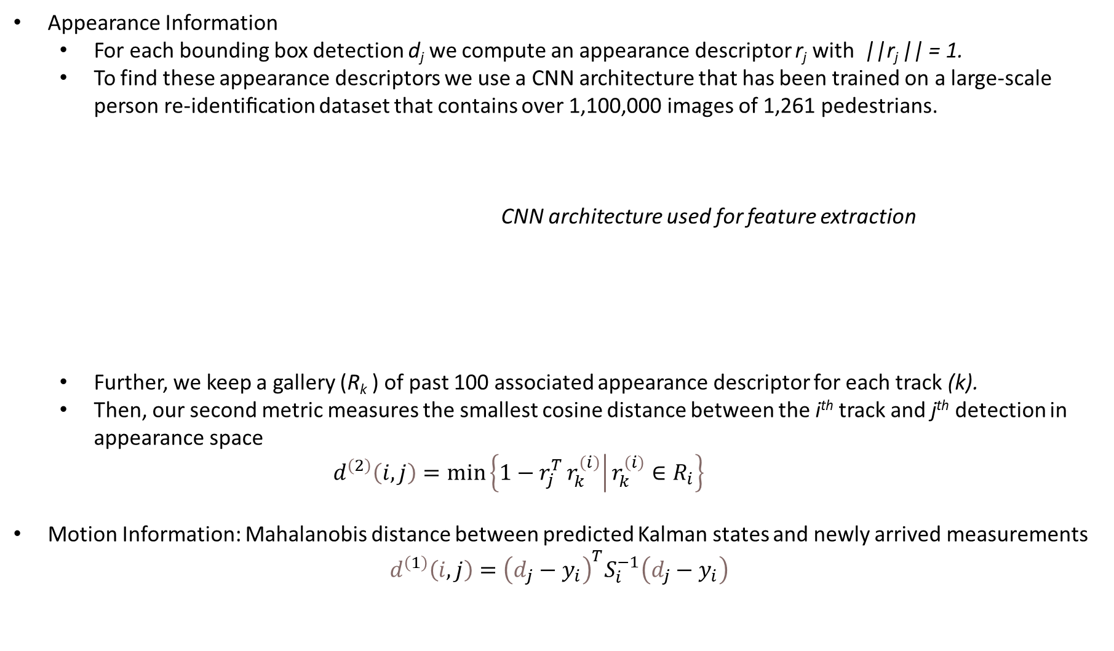
Sort with a deep association metric
Appearance Information
For each bounding box detection d_{j} we compute an appearance descriptor r_{j} with ||r_{j} || = 1.
To find these appearance descriptors we use a CNN architecture that has been trained on a large-scale person re-identiﬁcation dataset that contains over 1,100,000 images of 1,261 pedestrians.
CNN architecture used for feature extraction
Further, we keep a gallery (R_{k} ) of past 100 associated appearance descriptor for each track (k).
Then, our second metric measures the smallest cosine distance between the i^{th} track and j^{th} detection in appearance space $ⅆ^{\left(2\right)}\left(ⅈ,j\right)=\min\left\{1−r_{j}^{T}\left.r_{k}^{\left(i\right)}\right|r_{k}^{\left(i\right)}∈R_{i}\right\}$
Motion Information: Mahalanobis distance between predicted Kalman states and newly arrived measurements $d^{\left(1\right)}\left(i,j\right)={\left(d_{j}−y_{i}\right)}^{T}S_{i}^{−1}\left(d_{j}−y_{i}\right)$

Slide 25
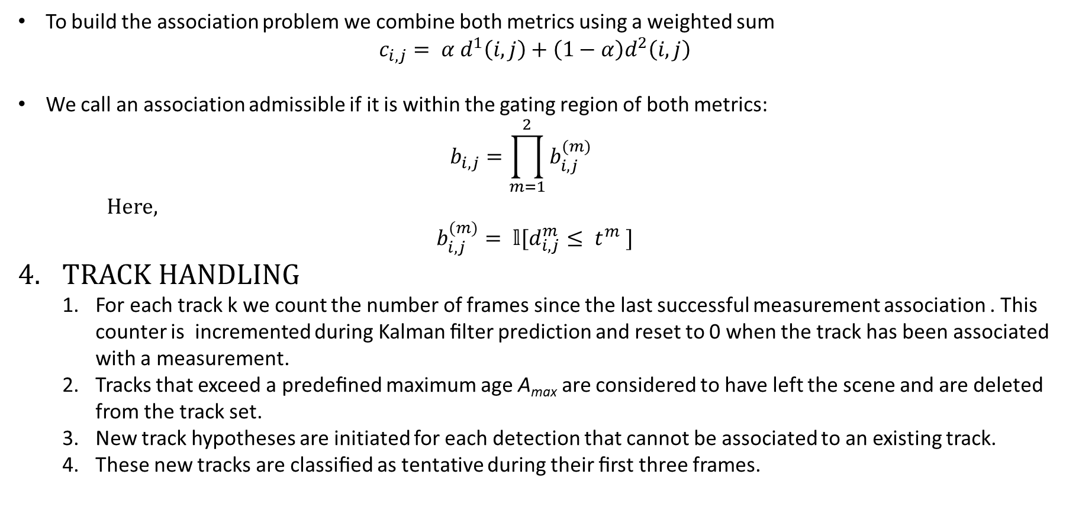
Sort with a deep association metric
To build the association problem we combine both metrics using a weighted sum $c_{i,j}= α{ d}^{1}\left(i,j\right)+\left(1−α\right)d^{2}\left(i,j\right)$
We call an association admissible if it is within the gating region of both metrics: $b_{i,j}=\prod_{m=1}^{2}{b_{i,j}^{(m)}}$
Here,
$$b_{i,j}^{(m)}= 𝕝[d_{i,j}^{m}≤ t^{m} ]$$
TRACK HANDLING
For each track k we count the number of frames since the last successful measurement association . This counter is incremented during Kalman ﬁlter prediction and reset to 0 when the track has been associated with a measurement.
Tracks that exceed a predeﬁned maximum age A_{max} are considered to have left the scene and are deleted from the track set.
New track hypotheses are initiated for each detection that cannot be associated to an existing track.
These new tracks are classiﬁed as tentative during their ﬁrst three frames.

Slide 26
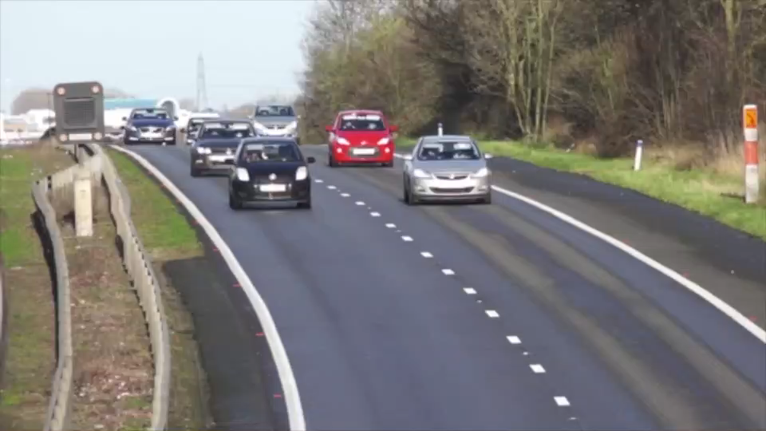
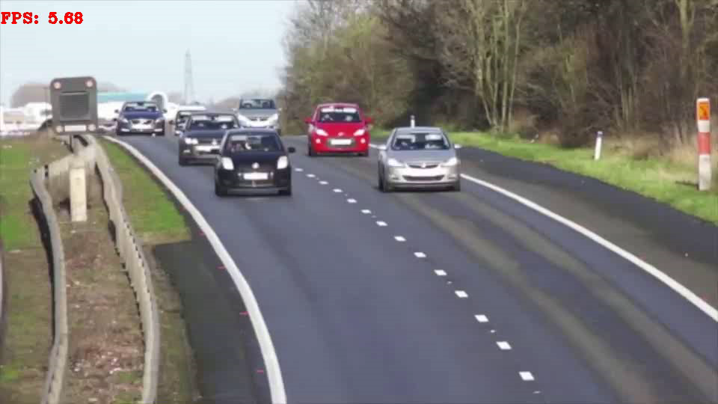
Our results
These are the results obtained on a Nvidia GeForce RTX-3060 mobile GPU

Slide 27
Our results
KITTI dataset
Results on KITTI Dataset
These are the results obtained on a Nvidia GeForce RTX-3060 mobile GPU

Slide 28
Our results
Lyft Level 5 dataset
Results on Lyft Level 5 Dataset
These are the results obtained on a Nvidia GeForce RTX-3060 mobile GPU

Slide 29
Fps obtained
 | LYFT LEVEL 5 DATASET AVG FPS MIN FPS |  | KITTI DATASET AVG FPS MIN FPS
NVIDIA GEFORCE RTX 3060 | 12.96 | 8.72 | 13.14 | 7.21
NVIDIA TESLA T4 | 14.19 | 11.69 | 14.04 | 9.36

Slide 30
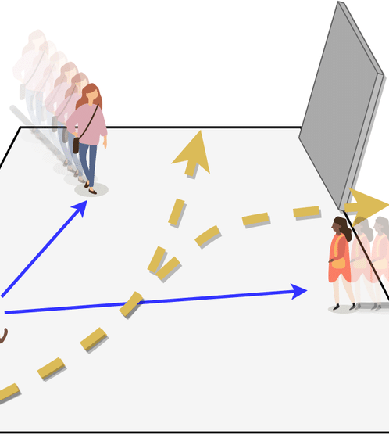
TRAJECTORY PREDICTION
Let’s Dive In

Slide 31
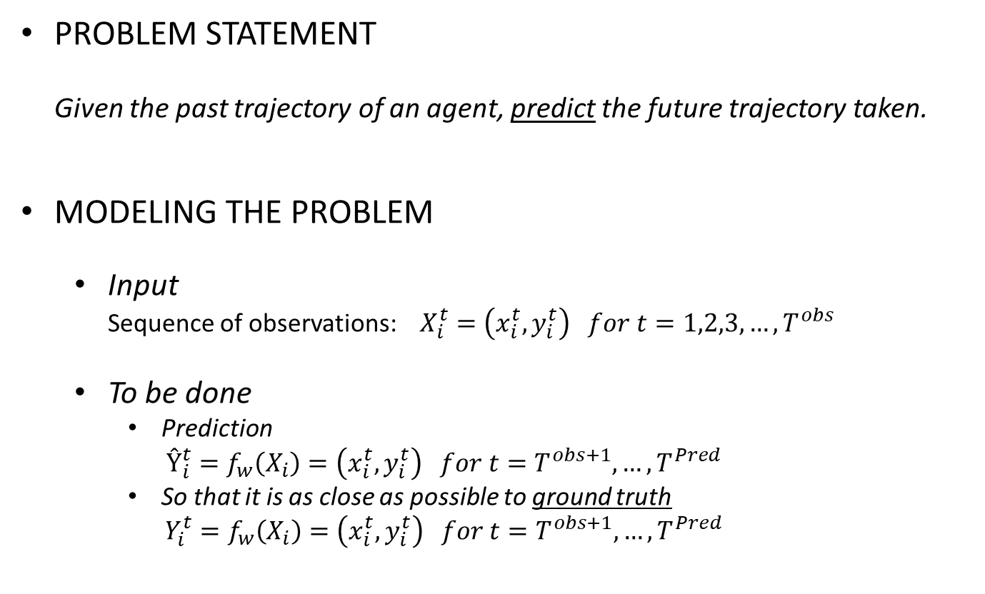
TRAJECTORY PREDICTION
PROBLEM STATEMENT Given the past trajectory of an agent, predict the future trajectory taken.
MODELING THE PROBLEM
Input Sequence of observations: $X_{i}^{t}=\left(x_{i}^{t},y_{i}^{t}\right) for t=1,2,3,…, T^{obs}$
To be done
Prediction $Ŷ_{i}^{t}=f_{w}\left(X_{i}\right)=\left(x_{i}^{t},y_{i}^{t}\right) for t=T^{obs+1}, …,T^{Pred}$
So that it is as close as possible to ground truth $Y_{i}^{t}=f_{w}\left(X_{i}\right)=\left(x_{i}^{t},y_{i}^{t}\right) for t=T^{obs+1}, …,T^{Pred}$

Slide 32
BACKGROUND AND PREVIOUS APPROACHES
SOCIAL FORCE MODEL (1998)
LSTM
SOCIAL LSTM
PECNET (Predicted Endpoint Conditioned Network)

Slide 33
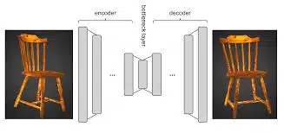
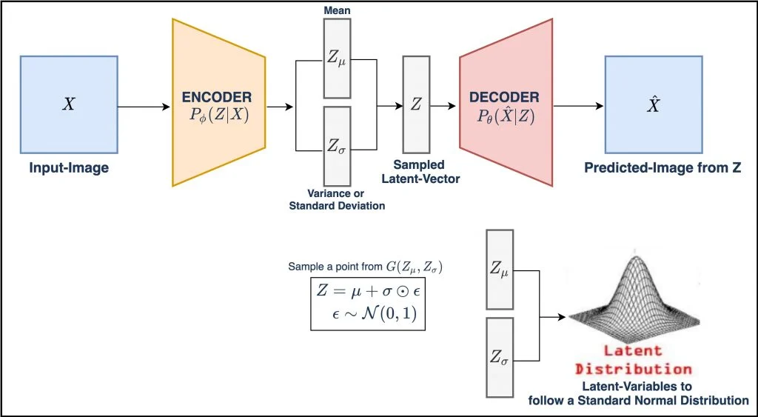
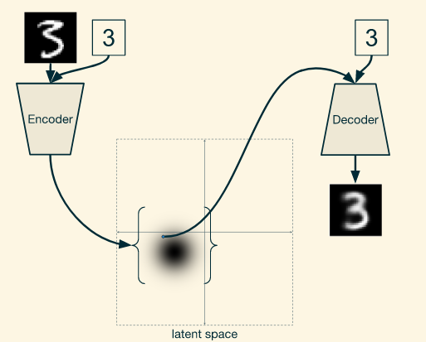
BUILDING BLOCKS OF PECNET
Encoder Decoder Architecture
Variational Autoencoder
Conditional Variational Autoencoder

Slide 34
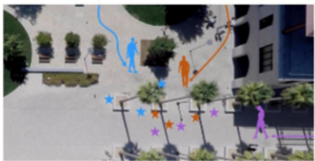
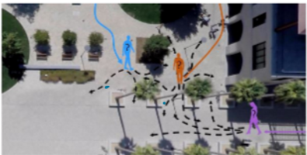
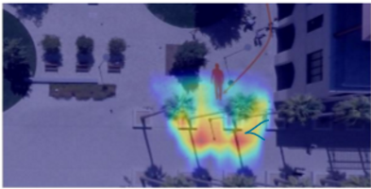
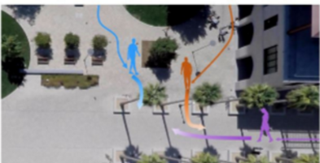
Working of pec net

Slide 35
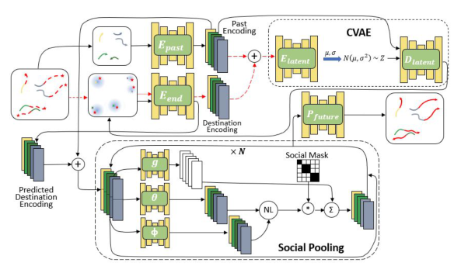
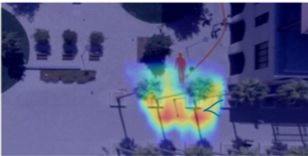
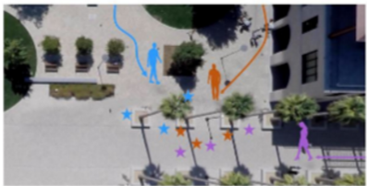

Architecture of pec net
WHILE TRAINING:
Encode past trajectory and Ground truth information
a) Concatenate and Encode to CVAE latent space with the encoder.
Decode the sampled latent vector with CVAE decoder conditioned on the past trajectory encoding
a) Re-encode estimated endpoints and form pool vectors for neighbours. b) Pool context for neighbours with social pooling module.
Jointly predict the future positions for all the neighbours with social context pooled information

Slide 36
Architecture of pec net
WHILE INFERENCE:
Encode past trajectory and Ground truth information
a) Concatenate and Encode to CVAE latent space with the encoder. b) Decode the sampled latent vector with CVAE decoder conditioned on the past trajectory encoding
a) Re-encode estimated endpoints and form pool vectors for neighbours. b) Pool context for neighbours with social pooling module.
Jointly predict the future positions for all the neighbours with social context pooled information

Slide 37
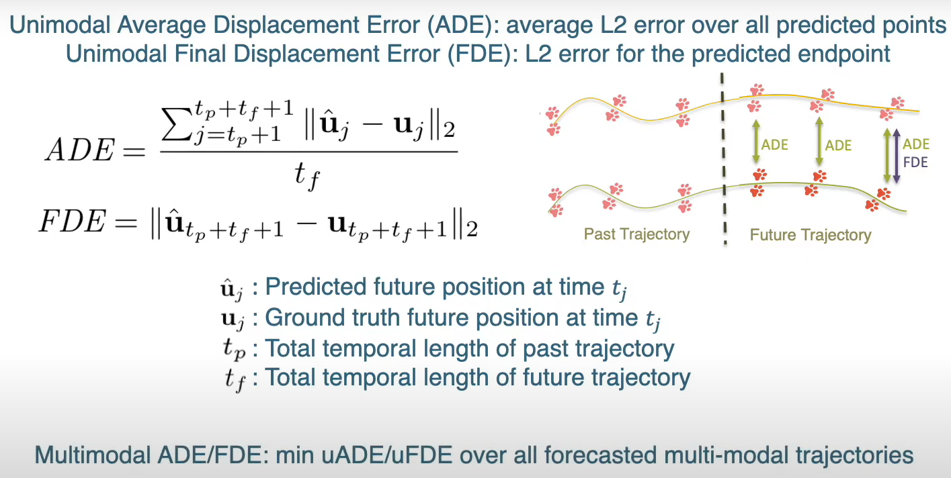
Metrics used

Slide 38
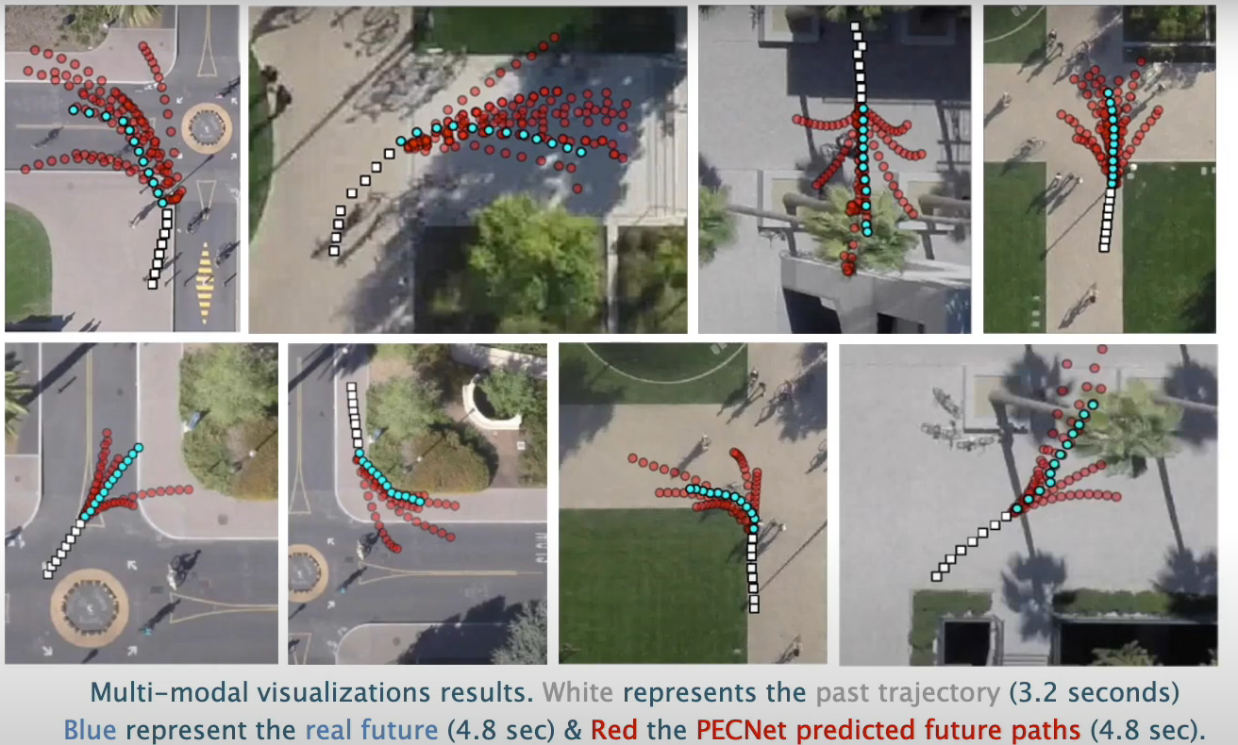
Results obtained

Slide 39
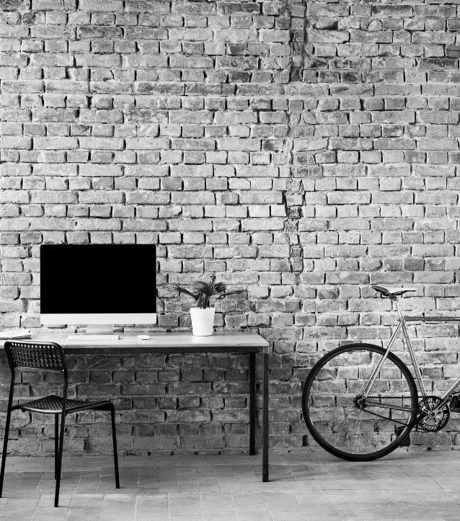
What’s next
LOOKING AHEAD

Slide 40
Project the detections into bird’s eye view so that they can be used for trajectory prediction
Optimize the codes for object detection and object tracking to attain better FPS
Including Lidar?
Intent Prediction (maybe using Reinforcement Learning)

Slide 41

applications

Slide 42
Supplement the localization and path planning module
Object tracking can be used in surveillance application
Object tracking+ Trajectory Prediction will help in intent prediction
Warehouse robots

Slide 43


THANK YOU
PLEASE REFER TO MY REPORT ON THE TOPIC FOR FURTHER DETAILS
VINIT AWALE
awale.vinit@gmail.com

